Slide 1


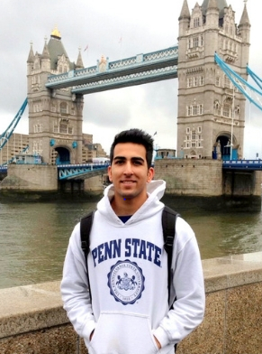


Tuesday, January 15th
4:00-5:00 Information Session
5:00-6:00 Internship Fair
6:30-7:30 Provider Meetings
      Arcadia (London) - 102 Business Building
      Connect 123 (Cape Town) - 103 Business Building
      CRCC Asia (Shanghai) - 107 Business Building
      CzechMates (Brno, Czech Rep.) - 104 Business Building
      IES Abroad (Santiago, Paris, Berlin, Dublin, Rome, London) - 124 Business Building
      The Intern Group (Hong Kong, Melbourne) – 122 Business

