Slide 1

The Smeal College of Business
Notes:
Congratulations on your acceptance into Actuarial Science and welcome to the Smeal College of Business.

Slide 2
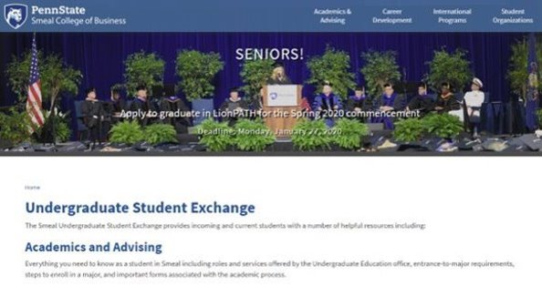
Smeal Undergraduate Education
202 Business Building
University Park, PA 16802
(814) 863-1947
SmealAdvising@smeal.psu.edu
ugstudents.smeal.psu.edu
Notes:
To assist with the transition into your major, you may find this Smeal exchange site to be very useful.
This is where you can schedule an appointment with your assigned advisor, find information on things like scheduling, minors, education abroad, internships and co-ops.
We recommend that you bookmark this site: http://ugstudents.smeal.psu.edu

Slide 3


Scheduling Presentation
Actuarial Science
Entering ACTSC Major in FA 25
Smeal Undergraduate Advising
Notes:
At this time, I would like to review the Actuarial Science curriculum for students scheduling for the Fall 2025 semester.

Slide 4

Recommended ACTSC Schedule
Fall 2025
RM 320 W
RM 410 or RM 411
BLAW 341 or BA 342
STAT 415
Gen Ed
Spring 2026
RM 421
ENGL 202D
BA 342 or BLAW 341
Gen Ed
Gen Ed
13 - 16 credits for the semester
https://ugstudents.smeal.psu.edu/academics-advising/degree-requirements/majors/actuarial-science-degree-requirements-2023
Notes:
To begin coursework in your major, it is crucial to schedule RM 320 W and RM 410 or RM 411.
Students should also schedule BLAW 341 or BA 342 in order to meet degree requirements.

Slide 5
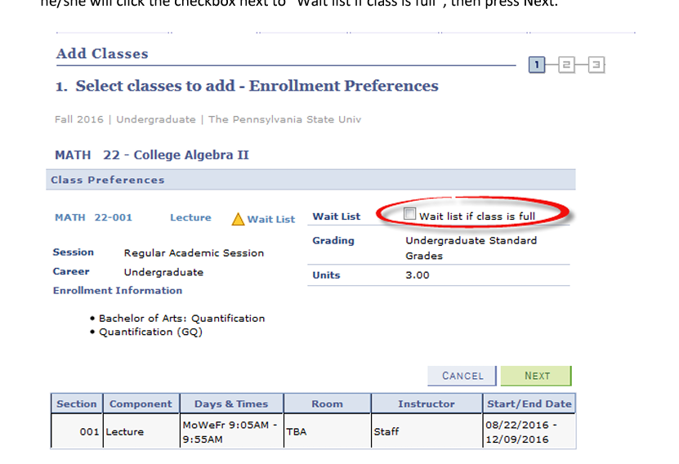
What To Do If a Course Is Full
If all sections of a course that you need to take for your major are filled, you should use the LionPATH Wait List system.
LINK: https://advising.psu.edu/scheduling-course-full
If it is a General Education course, you should find a suitable alternative.
Notes:
If all sections of a course that you need to take for your major are filled, you should use the LionPATH wait list system.
Before using the system, this link will take you to some common Frequently Asked Questions and a Waitlist tutorial.
Most importantly, you must check the box on LionPath that you would like to be added to the waitlist.
If it is a general education course, you should find a suitable alternative and then follow instructions on how to access the wait list in LionPATH for your first preference.
You can adjust your schedule if or when a seat opens in your first choice.
If you are accelerated in your curriculum, please consult with your academic adviser about what courses are appropriate.

Slide 6
ACTSC Courses
BA 411
ACTSC
Minor
Education
Abroad
Internship
https://ugstudents.smeal.psu.edu/academics-advising/degree-requirements/majors/actuarial-science-degree-requirements-2023
LINK:
Notes:
You may also want to consider scheduling courses that fulfill the two-piece sequence requirement.
A two-piece sequence provides you with the opportunity to take advanced level business courses outside of your major in order to broaden your educational knowledge base.
A link to this list is found at the bottom of the Recommended Academic Plan for Actuarial Science.
All Academic Plans are found on the Smeal Exchange website.

Slide 7


Smeal Minors
Information Systems Mgmt (ISM)
International Business (IB)
Supply Chain & Information Sciences & Technology (SCIST)
Legal Environment of Business (LEBUS)
See degree requirements for other Smeal approved minors
LINK: https://ugstudents.smeal.psu.edu/academics-advising/degree-requirements/minors
Notes:
In lieu of a two-piece sequence, you may complete a Smeal approved minor. The Smeal College of Business offers four choices:
Information Systems Management (ISM)
International Business (IB)
Supply Chain and Information Sciences and Technology (SCIST), and
The Legal Environment of Business (LEBUS)
As an example, if you are planning on completing the International Business minor, you may want to consider taking IB 303 in the fall semester.
Please see the degree requirements for approved minors and consult with your advisor, if you have any questions.

Slide 8
Smeal College Policy
Please note that pursuant to AACSB accreditation standards, the Smeal College requires that all upper division courses within the departments sponsoring the major be completed in residence at University Park under the instruction of Smeal College faculty.
For example, students in the Actuarial Science major must complete in residence with Smeal College faculty all 300 level and above Actuarial Science courses.
Petitions for hardship exceptions from this policy may be made to the Smeal College of Business Associate Dean for Undergraduate Education.
Notes:
Please note that pursuant to AACSB accreditation standards, the Smeal College requires that all Upper Division courses within the department sponsoring the major be completed in residence at University Park under the instruction of Smeal College faculty.
For example, students in the Actuarial Science Major must complete in residence with Smeal College faculty all 300 level and above Actuarial Science courses.
Petitions for hardship exceptions from this policy may be made to the Smeal College of Business Associate Dean for Undergraduate Education.

Slide 9

Request for Third Repeat of a Smeal Major Course
Request for third repeats of Major Field courses and other Smeal-taught Junior level required courses are not guaranteed.
Please keep this in mind when scheduling courses and avoid overloading your schedule with major courses and Smeal requirements. Drop/Add week allows for dropping a course with no penalty or Late Drop (LD) notation on your Academic Requirements report and your transcript.
You should consult with your adviser before making any decision about late dropping courses.
Example: FIN 406, if Late Dropped once, earned a grade of D or F the second time, may not be approved for a 3rd attempt.
Notes:
Students requesting to repeat a Major Field course and any other Smeal-taught Junior level required course are not guaranteed. Consult with your academic adviser when scheduling to avoid overloading your schedule. Drop courses during Drop/Add week to avoid a Late Drop. Earning a D or an F in a course or late dropping a course, each count as an attempt to take a course. A 3rd attempt for any reason may not be approved.

Slide 10
Interdomain or Linked
CAS 100
ENGL 202 D
Arts (GA)
General
Education
US or IL
Natural
Science (GN)
Humanities (GH)
Health & Physical
Activities (GHW)
Social & Behavioral
Sciences (GS)
World Language
LINKS: https://ugstudents.smeal.psu.edu/academics-advising/degree-requirements/foreign-language-policy
Notes:
To complete your schedule, please review your degree audit for any incomplete general education requirements including: GN/natural sciences, GA/arts, GH/humanities, GS/social and behavioral sciences, and GHW/health and wellness categories.
If you are planning on studying abroad, we recommend that you complete your natural science courses first, and then speak with your academic adviser about how you may fulfill some of your general education requirements while you are studying abroad.
Penn State requires students to take 3 credits of a United States culture (also known as US culture) and 3 credits of an International culture (also known as IL culture). Often you may fulfill a US or IL cultures requirement, while also fulfilling a general education requirement in the arts, humanities, or the social and behavioral sciences. These courses are identified on the Schedule of Courses by a US or IL after the course description.
Penn State also requires two Interdomain (Integrative Studies courses) to be taken while fulfilling the general education requirements. Be sure that you have earned a total of 6 credits in Interdomain coursework. These courses are identified with an ID after the course description.
You may also schedule courses such as World Language if you have not yet reached the 003 level, CAS 100 (public speaking) or English 202D (Business writing) in order to complete your Smeal general education requirements.

Slide 11
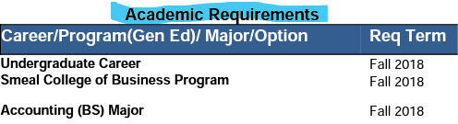
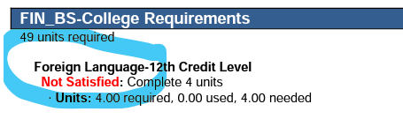
New Academic Report on LionPath
Now that you have declared your major it is important that you look at the correct report.
The “What If” report is no longer relevant.
The “Academic Requirements” report is what you will view to get an accurate picture of your requirements. There are two versions of the report. If you choose the PDF version, be sure to look for all courses that are Not Satisfied (see example below) on your report and plan to discuss courses that you need with your academic adviser. Below you will see that your major and any minor that you have declared will display.
Notes:
Now that you are in your Smeal major, you should be viewing the “Academic Requirements” report in LionPath and should view this often to keep track of courses that you have not yet satisfied.
This is the report that you will view when you work with your Academic Adviser. You will no longer use the “What If” report.

Slide 12
AT UP is here to help YOU!
(Assistance in Transition to University Park)
COBALT Leadership Program
Change of Campus Student Mentor Program
Social and Professional Development
Join Us:
Dawn Maguire, AT UP Adviser
dxv110@psu.edu
Notes:
Smeal is proud to offer assistance in transition to University Park.
An organization created to help students transitioning to University Park.
Please contact at AT UP advisor Dawn McGuire at email address dxv110@psu.edu for more information.

Slide 13
Things to do now that you are in Smeal (new to UP campus or from DUS)
Join or Update with Nittany Lion Careers
Attend the Change of Campus College Meeting
Attend the Department meeting for your Major
Meet with your assigned Smeal Academic Adviser
Prepare for the Fall Career Fair in early September
Attend Professional Events through the Smeal Business Career Center (BCC): including company information sessions, networking events, and BCC workshops
Learn more about Student Organizations through the involvement fairs
Attend the Education Abroad information session
Notes:
You should plan to attend the following fall semester activities:
The department meeting for your major held during the first week of classes.
The change of Campus College meeting.
The Fall Career Fair.
The Involvement Fairs - to learn more about student organizations, and
The education abroad information sessions that are held throughout the semester.
Also, be sure to join or update with Nittany Lion Careers.
It is also highly recommended to attend professional events through the BCC or Business Career Center here in Smeal.
Lastly, make an appointment in Starfish to meet with your assigned Smeal advisor.

Slide 14
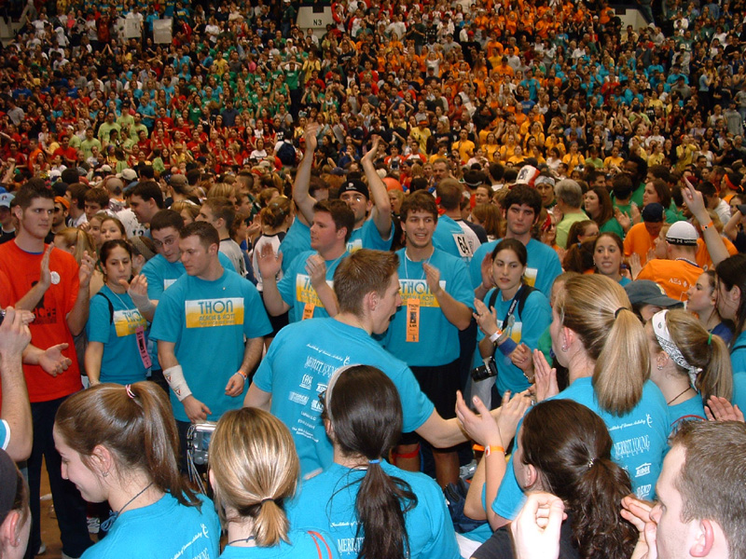
Student
Organizations
Get involved
Nearly 40 business-focused clubs & organizations
More than 1,000 university clubs & organizations
LINK: https://ugstudents.smeal.psu.edu/student-organizations
Notes:
As you begin your junior year, we encourage you to take advantage of all that Smeal has to offer.
Award-winning clubs and organizations.

Slide 15
Make the Most of Your Time
Leadership opportunities
Industry case competitions
Student organizations
Student research opportunities
Internships and Co-ops
Notes:
Exciting leadership opportunities.

Slide 16
Igniting Careers
Join Nittany Lion Careers once you arrive to University Park to schedule appointments with BCC consultants, RSVP for events, and search jobs and internships
Access the vast resources offered by both the Penn State Bank of America Career Services Center and Smeal Business Career Center (BCC)
Prepare for the University Park Career Fair
Smeal is a Top Choice for Corporate Recruiters
LINKS: http://studentaffairs.psu.edu/career/ and
http://ugstudents.smeal.psu.edu/careers
Notes:
An extensive career and internship support system.

Slide 17

Education Abroad
Gain a global perspective
Fulfill International Business minor requirements
Experience new cultures
LINKS: https://global.psu.edu/ and http://ugstudents.smeal.psu.edu/study-abroad
Notes:
And worldwide education abroad experiences.

Slide 18

Connect With Us
Notes:
“Like” us on Facebook and follow us on Twitter.

Slide 19
Presentation Links
Major Degree Requirements Page:
https://ugstudents.smeal.psu.edu/academics-advising/degree-requirements/majors/actuarial-science-degree-requirements-2023
Minor Degree Requirements Pages:
http://ugstudents.smeal.psu.edu/academics-advising/degree-requirements/minors
General Education Information:
https://bulletins.psu.edu/undergraduate/general-education/
http://ugstudents.smeal.psu.edu/academics-advising/degree-requirements/foreign-language-policy
Education Abroad Links:
https://global.psu.edu/
http://ugstudents.smeal.psu.edu/study-abroad
Career/Internship Links:
https://studentaffairs.psu.edu/career
http://ugstudents.smeal.psu.edu/careers
Smeal Student Organizations Link:
https://ugstudents.smeal.psu.edu/student-organizations
Waitlist Information Link:
https://advising.psu.edu/scheduling-course-full
Notes:
Lastly, for additional information, please visit the links that were referenced throughout this presentation.
We look forward to meeting you and assisting you in your journey in the Smeal College of Business.

